Slide 1
Defense Capability Management
3D Asset Model
Niek Freriks
14-Sep-2021

Slide 2

Goal

Slide 3
Goal
Of the extension
Hotspot's data coming from worksheet
Worksheets respond on click
Flexible extension
No code implementation
Configurable 3D model

Slide 4
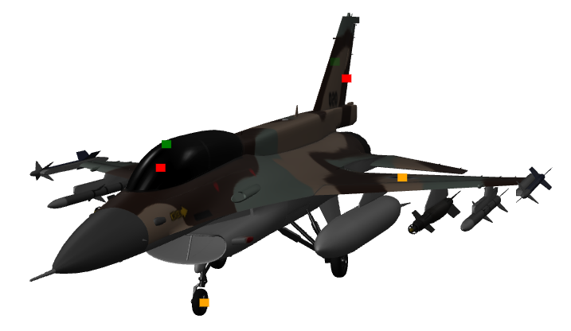
Goal
Example Workbook
Worksheet
Worksheet
Worksheet(s)
Interaction
Summary Worksheet
Provides Color and Tooltip Data

Slide 5

So Far

Slide 6
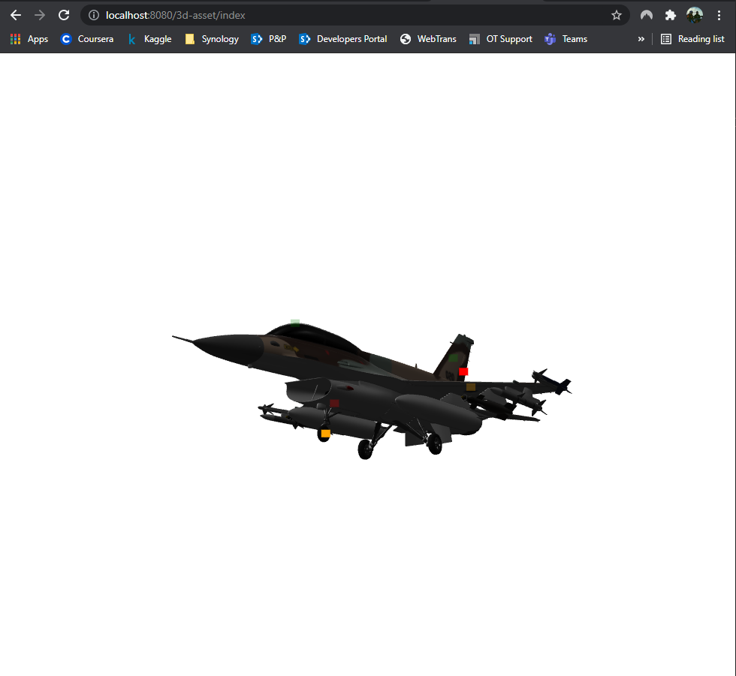
So far
Created my first extension!
Kind of….

Slide 7
So far
files
JavaScript
HTML
3d-asset.js
index.html
Tableau.extensions.1.latest.min.js
model-viewer.min.js
CSS
Assets
style.css
F-16D.gltf

Slide 8
So far
How
Dynamically add hotspots to the extension based on data in worksheet
Use the hotspots in the model-viewer to interact with other sheets
Update the hotspots based on changed (filtered) data

Slide 9

DATA

Slide 10
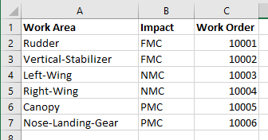
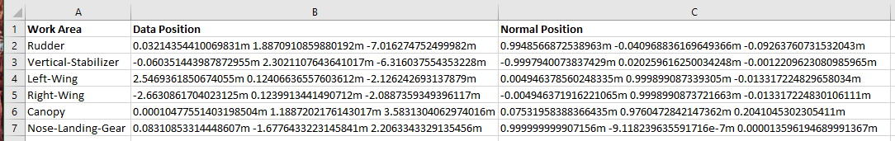
DAta
Excel File
Fact
Dimensions
Note: this is a representation of the data and not the actual ILIAS format

Slide 11
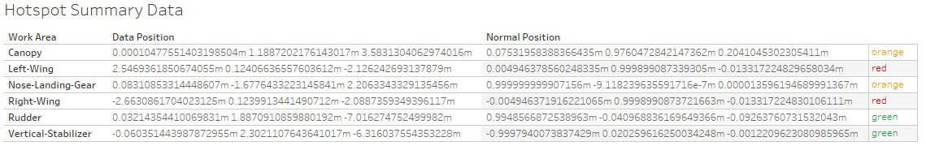
DAta
Tableau sheet
Worksheet name: Hotspots
Limit to 1 3D model at a time
3D Model
KPI
Tooltip
F-16D.gltf
Description….
F-16D.gltf
Description….
F-16D.gltf
Description….
F-16D.gltf
Description….
F-16D.gltf
Description….
F-16D.gltf
Description….

Slide 12
Get data with getSummaryDataAsync
Loop over each row with foreach
var cubes = [ [1, 2, 3], [4, 5, 6], [7, 8, 9], ]; for(var i = 0; i < cubes.length; i++) { var cube = cubes[i]; for(var j = 0; j < cube.length; j++) { display("cube[" + i + "][" + j + "] = " + cube[j]); } }

